Slide 1

Boca Highland
Town Hall Meeting

Slide 2
Agenda
About Blue Stream Fiber
Network Construction
In-Home Installation & Sign-Ups
Products & Services
Upgrade Options
Customer Education Resources
Questions

Slide 3
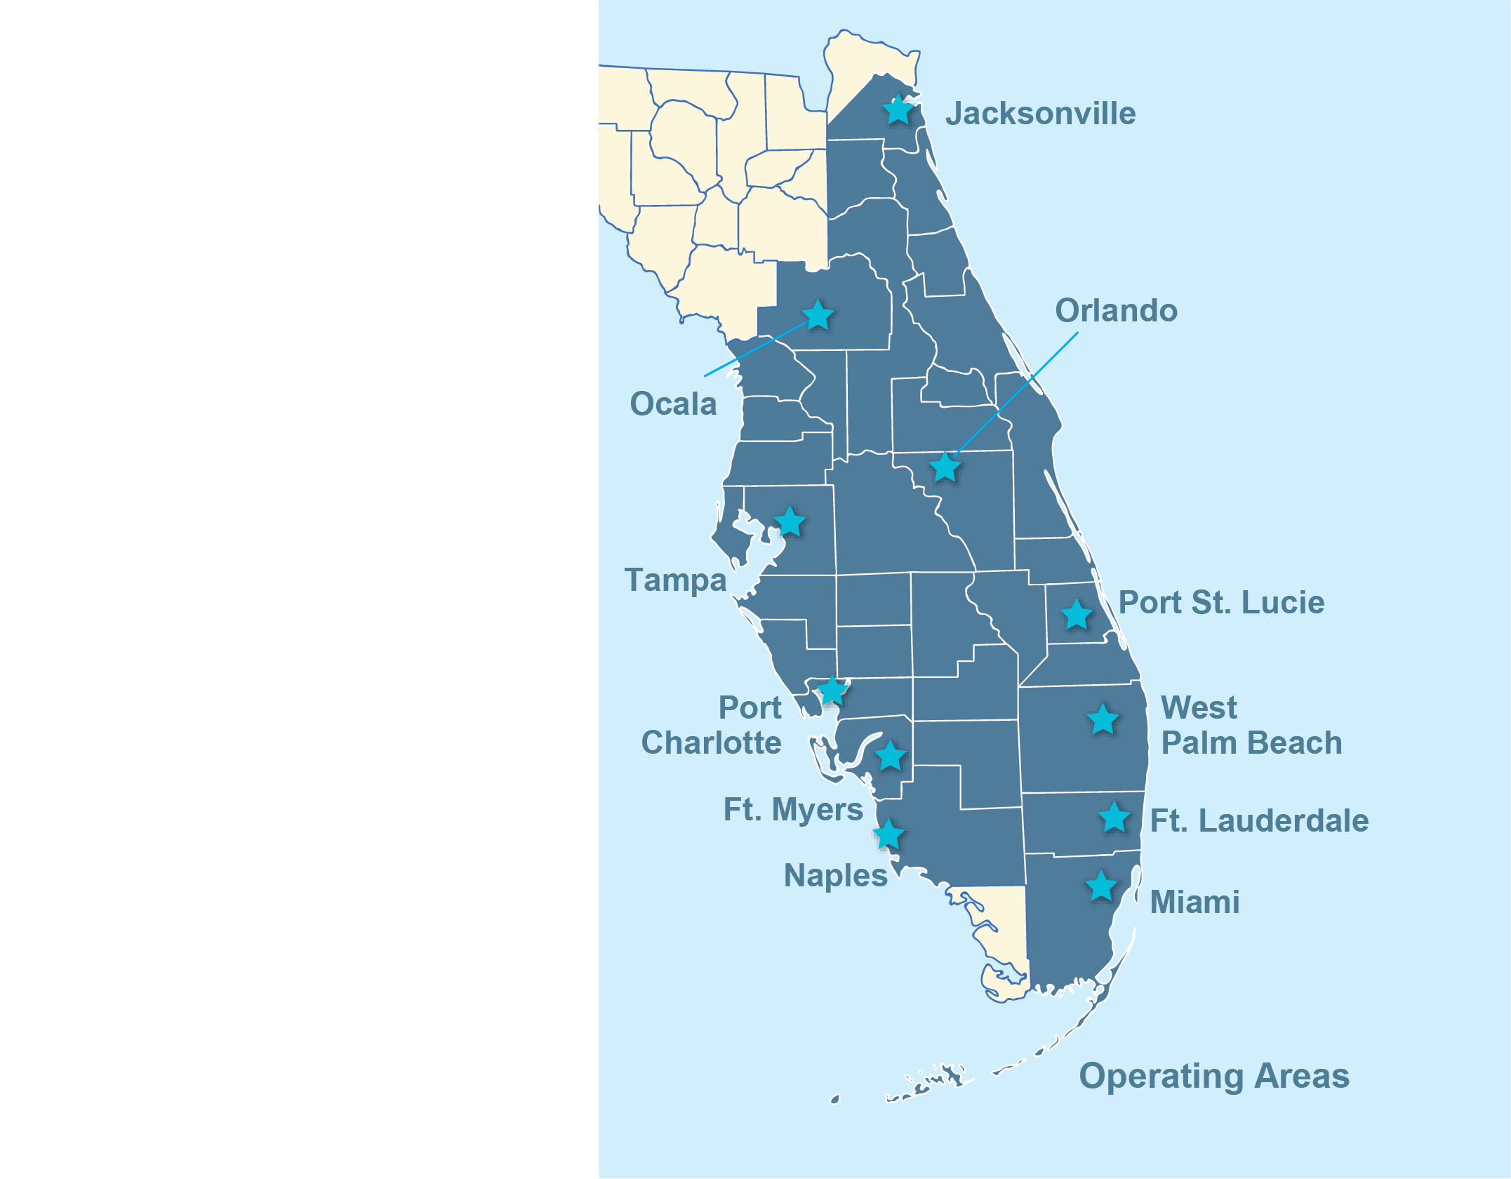




About Blue Stream Fiber
Trusted Florida Based Communications Provider for Over 45 Years
Fiber: Fiber-to-the-Home Service since 2002
Internet: Fiber Internet with Total Home WiFi
TV: 300+ channels available, TiVo & Google TV with Network DVR
Phone: Unlimited with 29 features & voicemail

Slide 4

What Makes Blue Stream Fiber Different?
RELIABILITY
Fiber Optics (No Shared Network)
Redundant Network
Wall-to-Wall WiFi Coverage
CUSTOMER SERVICE
Dedicated Account Manager
100% US-based customer service
BEST TECHNOLOGY
Symmetrical Speeds from Fiber
World-Class TV: TiVo DVR, Google Apps, Voice Remote
Future Proof with Contractual Upgrades
Notes:
Check/Confirm the Contract/Sales Handoff for Redundant or Protected Speed – usually 500+ units (IF NOT IN HANDOFF, Check with Chris Brown)
**AM TO Call out the US-based customer service.

Slide 5

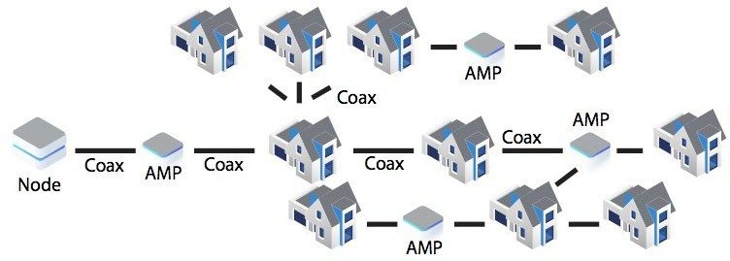
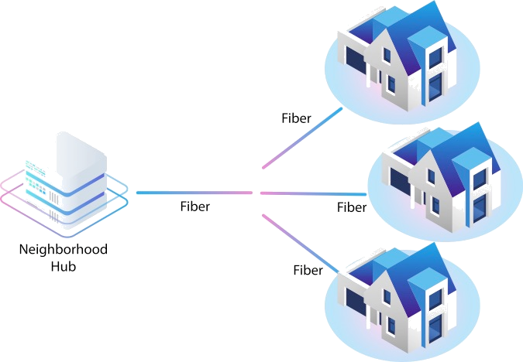


What Makes Fiber Different?
Traditional Coax Network
New Blue Stream Fiber Network
Improved Reliability & Uptime
Faster Speeds
Future Proof
Increased Home Value
Shared Bandwidth with ~ 300 Homes Amplification of Signals
Limited Capacity
Vulnerable to Environmental Factors

Slide 6

Customer Service Guarantee
Dedicated customer support line
100% US-based customer service
Guarantee speeds and 99% uptime
Performance reports available
Notes:
Quarterly report available
NOTE: If Strategic - add dedicated staff, etc.

Slide 7






Customers Love Blue Stream Fiber
4.2 stars
5,342 Google Reviews
Notes:
GOOGLE → Blue Stream Fiber Coral Springs – will show current stars and counts

Slide 8

Easy Install: Highly Satisfied Residents
“Chad was extremely knowledgeable, professional and prompt. A credit to your company.”
“Courteous Efficient and took care of the problem +++.”
“The technician was very knowledgeable and able to set up the TV and made it look outstanding with color and explained the remote usage as well. Plus, I was able to get service in 24 hours.”
“Very knowledgeable and he was very informative, and everything is working much better. Very glad we got this individual to take care of the problems we were having.”
Notes:
Net Promoter Score (NPS) is a measure used to gauge customer loyalty, satisfaction, and enthusiasm with a company that’s calculated by asking customers one question:
“On a scale from 0 to 10, how likely are you to recommend this product/company to a friend or colleague?”
Aggregate NPS scores help businesses improve upon service, customer support, delivery, etc. for increased customer loyalty.

Slide 9
Network Construction, In-Home Installations, and Sign-Ups

Slide 10
A No-Stress Transition to Blue Stream Fiber
BLUE STREAM FIBER GUARANTEE
SMOOTH CONSTRUCTION
EASY INSTALLATION
100% underground network
Dedicated construction oversight
Fix and repair landscaping each week unless permitting required
Strategic, minimally invasive techniques utilized
One-visit install of fiber optics and all services
In-home, one-on-one training at installation
Configuring of WiFi devices, set-top boxes and voice remotes
One-hour in-home training available during installation phase
Redundancy to Keep Your Community Online
Guarantee speeds and 99% uptime
Virtual tech support
100% U.S.- based customer service team
Same day/next morning in-home tech support prioritized for residents with a full-service impact

Slide 11
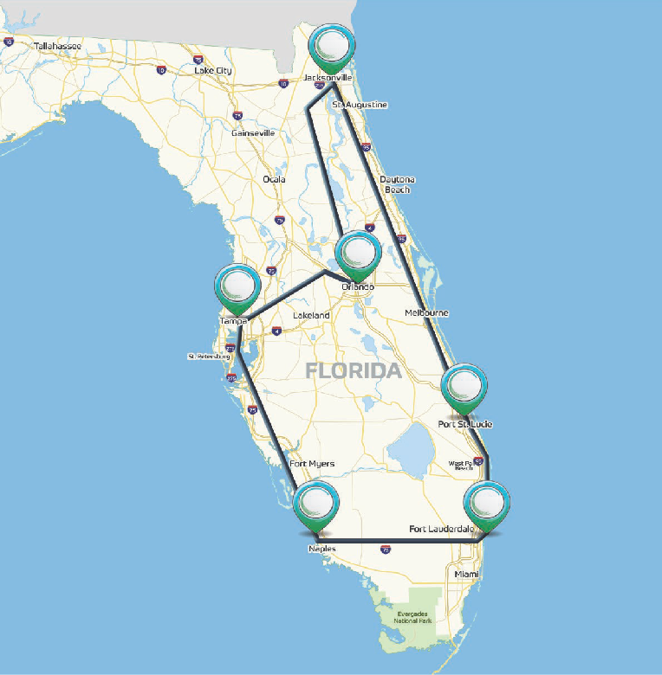
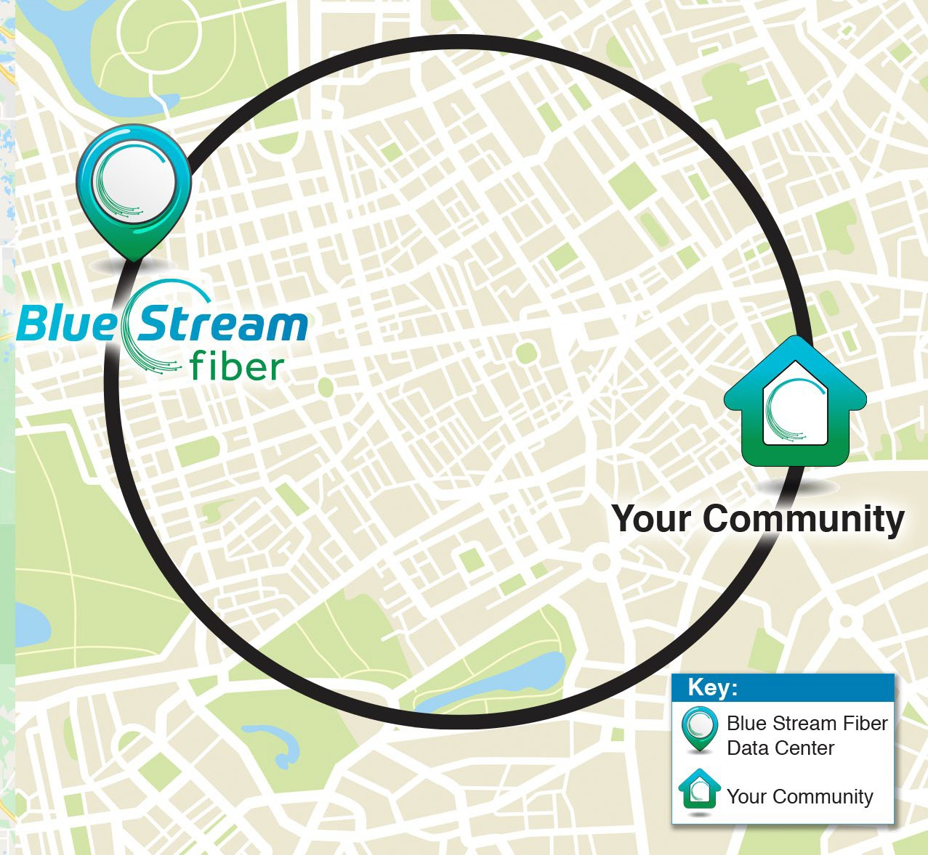
Blue Stream Fiber Guarantee: Redundancy
Statewide Ring
Local Ring
Notes:
STATEWIDE RING AND LOCAL RING ARE REDUNDANT! (TBD on actual community)
Network Redundancy is a system of backup pathways in a fiber optic network that ensure uninterrupted and reliable internet connectivity, even in the event of an outage.
Think of it like having multiple roads to get to your destination. If one road is blocked due to an accident, you can take another route and still get to your destination. Similarly, in a fiber network, redundancy means that there are multiple pathways for data to travel through, so if one pathway is disrupted for any reason, data can still reach its destination using an alternative pathway.
This redundancy is important because it ensures that if there is any disruption to your internet connection, you will still be able to access the internet using a backup pathway. This means that you can continue to stream videos or browse the internet without any interruption.

Slide 12

Service Updates
Construction of Fiber expected to be completed by beginning of May.
On-Site Registration estimated April 29 – May 3.
Call-in registration dates will begin April 30.
Installation period is expected to begin in early May.
Notes:
Select/Modify Call-In Process based on property type and rollout – Update dates based on breakdown.

Slide 13

Products & Services

Slide 14
Bulk Internet Services (included with HOA Dues)
Your Community will receive internet with speeds of 1 GIG
Symmetrical Internet speeds of 1 GIG that include a modem, perfect for streaming, surfing, gaming, or working from home!
Every 2-years internet speeds increase by 100 bps.
24X7 remote monitoring of the home network, including nightly, automated health checks.
Total Home WiFi through our Latest-Generation WiFi Pod technology means reliably fast internet speeds throughout your home (requires professional install by Blue Stream Technician).

Slide 15
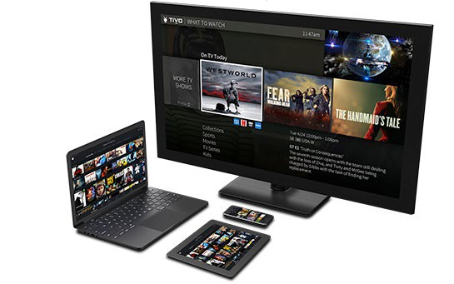
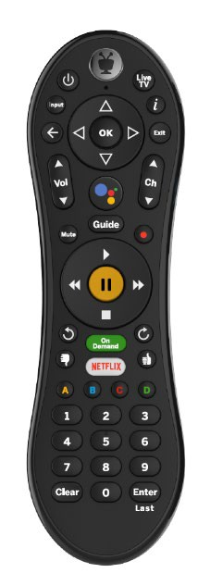


TV Services (Included with HOA Dues)
Your Community will receive below:
Digital Core + Plus TV Package with 300+ Channels
HBO + MAX and Sports Plus
TiVo with Android TV/Google Assistant
Cloud DVR (200 hours included)
(4) HD capable Set-Top Boxes
(4) Voice Remotes
Video on Demand
Blue Stream Fiber TV App for watching TV at home or on the go!
Notes:
Speak to HD available!

Slide 16

Sign Up for Your Consultation
Option 1: On-site Consultation Appointment with a Blue Stream Fiber representative. You will receive a flyer via email with a link to sign up for these appointments.
https://www.signupgenius.com/go/BocaHighland
Option 2: Call-in Appointment to speak with a Blue Stream Fiber representative and schedule installation. We will release your dedicated community number via email on April 30 to call in.
Notes:
TBD Sign Up Genius Link based on time of registration versus town hall.
TBD Call In Dates based on confirmation of launch.

Slide 17
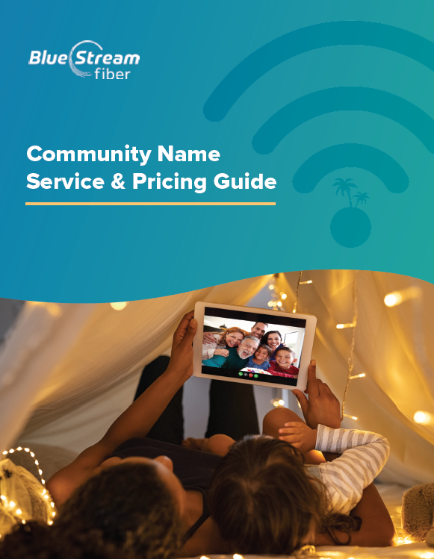
Service and Price Guide
Closer to registration, residents will receive a packet that covers the following topics:
Community package details
Upgrade package options
Channel Line Up
FAQs
Customer education resources
Notes:
**SPEAK TO DISTRIBUTION AT TOWN HALL OR ON-SITE REGISTRATION**
**Request PDF version from Marketing to send out as needed.

Slide 18

Smart, Total Home WiFi

Slide 19


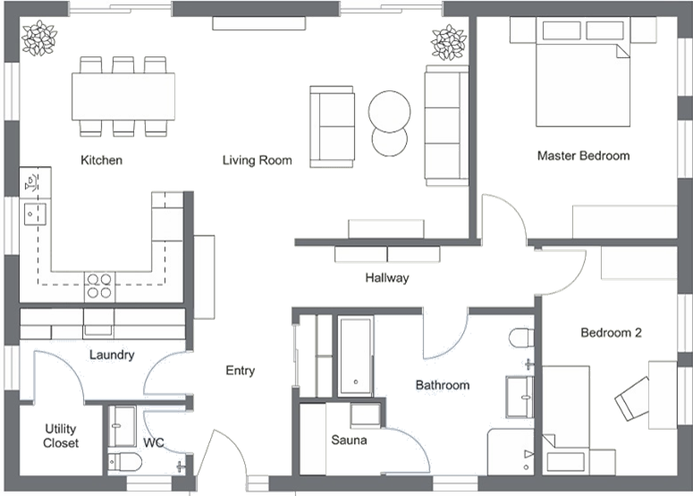

What Makes Total Home WiFi Better?
Blue Stream Fiber Total Home WiFi
Standard WiFi

Slide 20
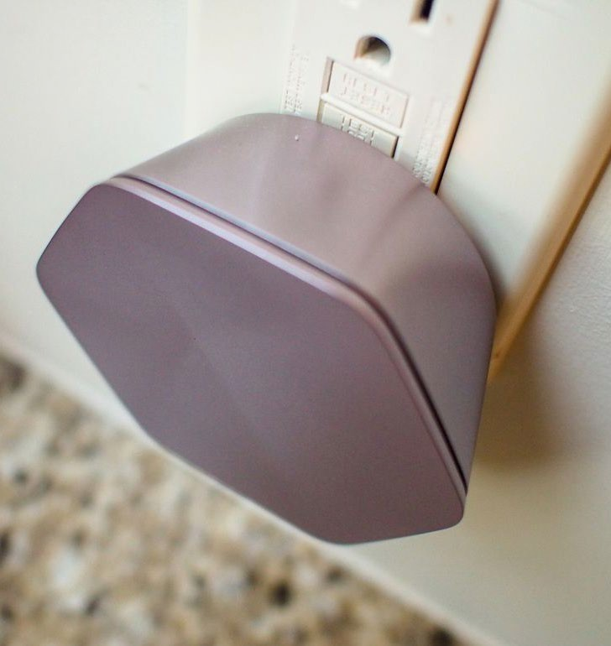
Total Home WiFi
Included with our Fiber Internet Service
Better In-Home Service and Coverage
Total Home Coverage – Not just a router
WiFi Assessment by Engineering Team
Automated WiFi Health Checks and adjustments
Better For You
Built-in security software for all devices
Control your network via an app (if you want)
Set up guest networks, control access

Slide 21

Television Services

Slide 22



Easy-to-use Voice Remote & Ultra Slim Set-Top
Say things like “Fast forward three minutes”, or “Watch NCIS on now”, or “Find some action movies.”
Supports 4K HD TV
Small set-top works when hidden behind TV!
Enhanced customer support through virtual technician system

Slide 23
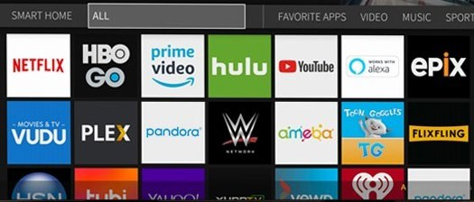


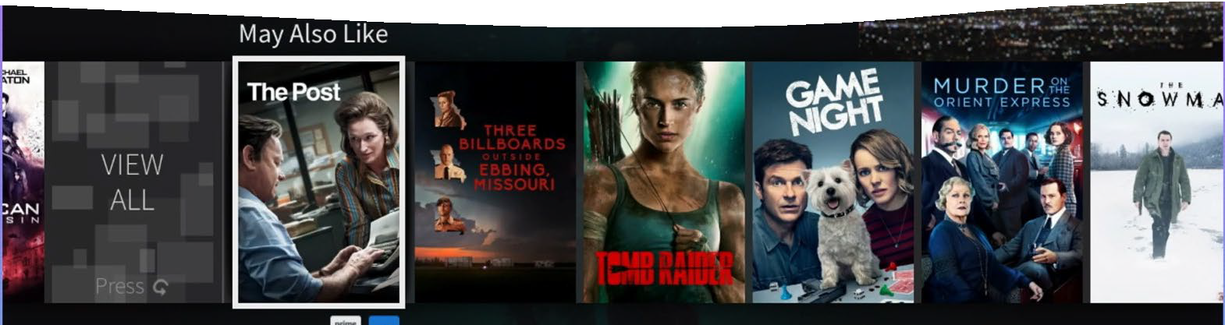
The Power of Android TV & TiVo
The Best of Traditional TV, Apps, and an Advanced Voice Remote
Simple, easy-to-use guide
Visual display with poster art
Any screen in any room
Easily find, play, record, and delete your shows
Network DVR, Start Over & Catch Up
Get recommendations on what to watch
Say it. See it. Watch it
Google Assistant

Slide 24
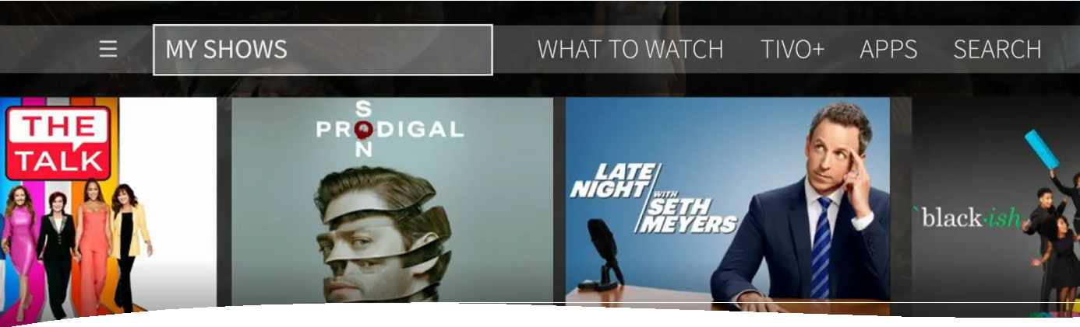
Record All Your Shows
Record All Your Shows
Cloud DVR Storage
Set up single episodes or series recordings
Watch recordings from any device, anywhere

Slide 25







Easy Access to Your Favorite Apps
& Google Assistant
Access to over 5,000 apps on the Google TV Play Store
Find movies with your favorite actor, quickly access the score of the football game or get tomorrow’s weather – all from your set-top box
Powerful Voice Search to simultaneously search across Live TV, Recordings, & Streaming Services

Slide 26


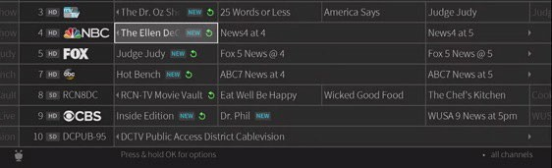
Start Over & Catch Up
Never miss what's important to you
Start Over: If you start watching a live show when it is already in progress, you can start over from the beginning.
Catch Up: If you missed the episode when it aired, Catch Up lets you watch it after the fact.
*Availability depends on show and programming rights

Slide 27

Google Assistant
Use your voice to do more!
Press and release the Google Assistant button & ask Google to give you the weather or check the score of the game. You can even connect to your Google Smart Home devices and dim the lights or adjust the thermostat!
Plan Your Day
“Hey Google, will it rain today?”
“How long will it take to get to Fort Myers?”
Play & Discover Content
“Play Chicago Fire”
“Show me Action Movies with Bruce Willis”
Get Answers
“Who won the Super Bowl in 1995?”
“What is the date of Easter in 2021?”
Control Google Home Devices
“Dim the bedroom lights”
“Set the temperature to 73 degrees”

Slide 28




Our TV Service Works With
Your Devices
Phones & Tablets
Amazon Fire TV Sticks Apple TV
Watch Live TV, On Demand and Recordings in Your Home
Notes:
For additional TV’s you can opt for additional set-top boxes, or you can use the Blue Stream Fiber app to stream our services.
We do recommend that you have a box on all TV sets to take full advantage of the Blue Stream Fiber TiVo platform and have access to the 5000+ apps.
You can use an Amazon Firestick or Apple TV as a substitute and get most of the abilities, i.e., voice remote and Google Assistant.
For the best viewing experience utilizing the Amazon Fire Stick, we suggest any current generation 4K streamer. Older Generation 2 streamers’ fire sticks will work but will not receive 4K streams.
***Unfortunately, at this time, Roku does not work with TiVo’s operating system, so the Blue Stream Fiber TV app will not work on Roku BUT can use a firestick on Roku TV.

Slide 29

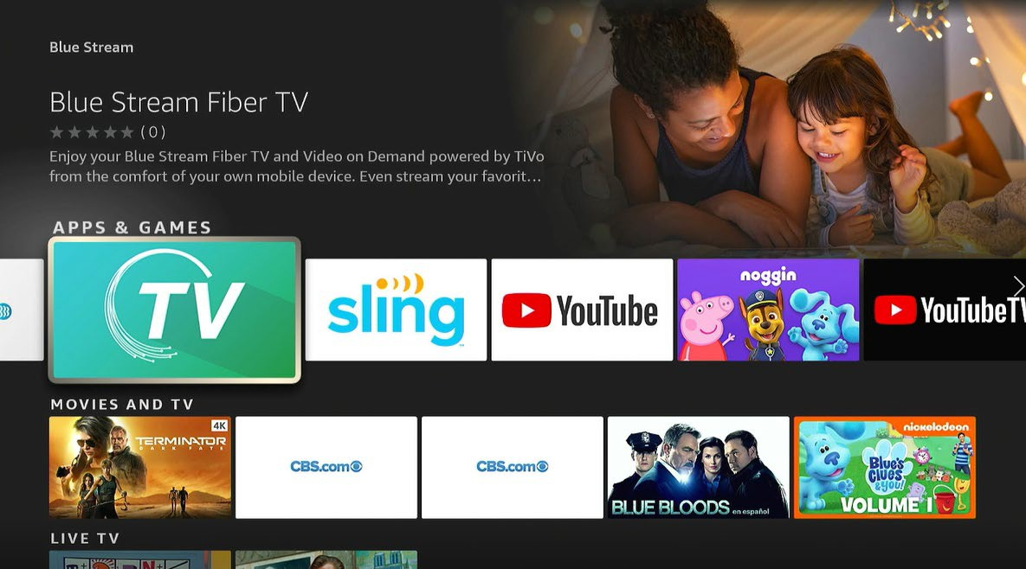
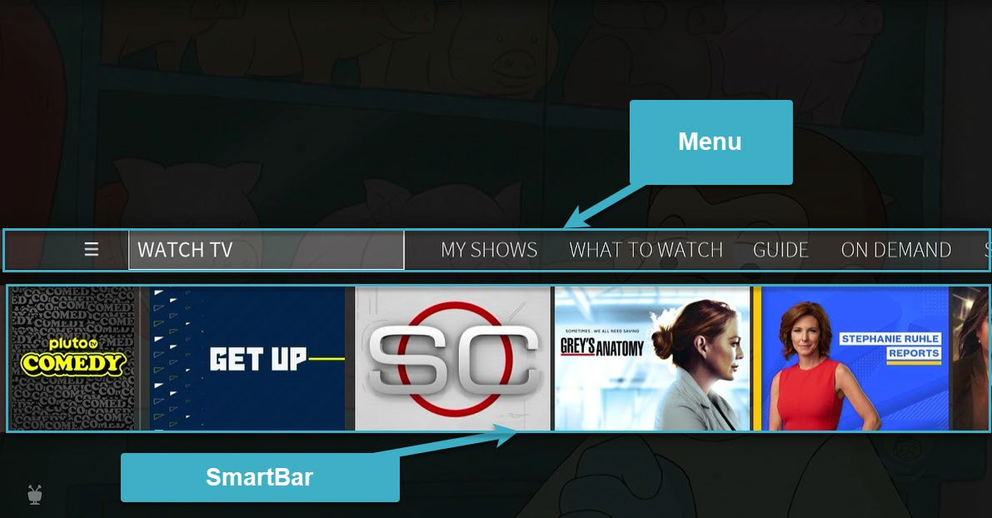
Blue Stream Fiber TV App
Watching Live TV and more on-the-go
With new Blue Stream Fiber TV app, customers can watch live TV, access recordings, and watch on demand content on the go! Simply download the app on a mobile device, Fire TV stick or Apple TV, enter the WatchTVEverywhere log in and enjoy!
For more information on the Blue Stream Fiber TV services and the App, access bluestreamfiber.com/tivo
Notes:
**

Slide 30
Blue Stream Fiber TV Experience
Set-Top Box
Full functionality
Blue Stream Fiber TV App on streamer
Modified functionality
Live TV
Interactive guide
DVR Recordings
PPV
Voice Remote
Access to apps on Google Play Store (Netflix, Hulu, etc.)
Integrated search across live TV and many apps
Plus, an additional 160+ free, binge-worthy channels via TiVo+
Live TV
Interactive guide
DVR Recordings
Video on Demand
Access to apps on Google Play Store (Netflix, Hulu, etc.)
Notes:
Better experience in the home if have a setup inside the home.

Slide 31
Seasonal Resident Information
What you need to know!
Q. I am a seasonal resident and will not be in town during my installation, what should I do?
A: Seasonal residents can be installed when they return. Simply call your Blue Stream Fiber Community number seven days prior to your arrival.
Q. I am a seasonal customer. Do you have seasonal rates to put my optional services on hold at a reduced rate?
A: We do offer seasonal service rates. For TV and Internet, the season rate is $8/month plus taxes and fees. For phones, the seasonal rate is $6/month plus taxes and fees. Seasonal residents can put services on hold once a year for 2 - 9 months.
Q. Can I take my TV services with me when I go back up north or travel?
A: Yes, by downloading the Blue Stream Fiber App to an Amazon Fire Stick, Apple TV, or Android TV. Please note, local channels will not work outside of your local TV area due to FCC regulations.

Slide 32

Upgrade Options

Slide 33
A-LA-CARTE OPTIONS
Cable Upgrade TV Options
Internet Upgrade Options
2 Gbps Upload/Download
2.5 Gbps Upload/Download
Paramount+ with Showtime
Cinemax
Starz
Encore
Blue Latino
RAI Italia (Italian)
RTN (Russian TV Network)
TV5 Monde
$11.99/mo
$10.00/mo
$14.95/mo
$6.95/mo
$11.95/mo
$9.99/mo
$14.95/mo
$9.95/mo
$35.00/mo
$50.00/mo
Phone Option
Unlimited Phone Service
$19.95/mo
Home Protection Plan
Additional DVR Hours
DVR 150 Hours
DVR 300 Hours
DVR 500 Hours
$7.95/mo
• Accidental Fiber Damage
• External wiring issue caused by animal or contractor damages
• Accidental damage to phone wiring
• Accidental damage to Modem or ONT
• Basic customer education
• Assistance with seasonal return reconnection should it be needed
$5.00/mo
$10.00/mo
$15.00/mo
Pricing subject to change.
For more information on taxes and fees, please visit: www.bluestreamfiber.com/taxes-fees.
Notes:
**USE MONTESERRAT FONT**

Slide 34

Understanding Your WiFi Speeds
Bandwidth - Home Network Speeds vs. Wireless Speeds
  Your internet speed over WiFi “wireless speed” will not be identical to the speed you subscribe to, known as your “home network speed.” In reality, the internet speed over WiFi will rarely match the subscribed home network speed, due to the nature of WiFi technology.
  If you want to determine if you are receiving your subscribed internet speed, you must perform the speed test while the device is hard-wired to your home network.
  When you are testing your WiFi speeds, you are really testing the MAXIMUM speed that the device running the test can attain, not the maximum that your home network provides.
Notes:
Speak to “ideal” and it does not mean their internet wont work.
Listing possible connected devices helps them understand the speed effect (sometimes people think in terms of laptops, computers only). We want to give them a sense of what they need to consider
This could be a great lead in to “or we can make it easy for you with these bundle packages!”

Slide 35

Understanding Your WiFi Usage
Many factors contribute to how your devices utilize WiFi.
  The Internet speed of any particular device connected to your home network is limited by that device’s capability; it is not a reflection of the speed of your entire home network.
  For example, customers with 1 Gig service will only achieve this speed if the device they are using can attain those speeds. In fact, most devices in one’s home – laptops, smartphones, smart TV’s, gaming consoles, etc. are designed to only use a portion of that speed. And… that’s OK!
  Internet speed is about the power that internet speed has to drive optimal performance on the multiple devices that are connected to your home network.
Similar to power and generators, the higher the home network speed, the more the connected devices within the home are optimally supported.
Notes:
Speak to “ideal” and it does not mean their internet wont work.
Listing possible connected devices helps them understand the speed effect (sometimes people think in terms of laptops, computers only). We want to give them a sense of what they need to consider
This could be a great lead in to “or we can make it easy for you with these bundle packages!”

Slide 36


OUR MOST POPULAR ADD-ON PACKAGE!
TOTAL CONNECT PACK
just $19.99/mo
Up to 1 Gig Speed Upgrade
Managed WiFi pods where needed for full in-home WiFi coverage
Additional Set-Top boxes for all your TV’s
500 DVR Hours
Unlimited In-home Concurrent Streams
Home Protection Plan
All home visits are completely covered
Plus 2 free months of HBO with access to the Max app*!
Savings of more than
$600 a year!
ADD UNLIMITED PHONE SERVICE FOR ONLY $19/mo!
NOTE: Package components may vary based on what is included in your community’s agreement. *After 60 days the current rate for HBO will be applied unless canceled by the customer prior to the end of the complimentary 60-day period. Pricing is subject to change. For more information on disclaimers, taxes, and fees, please visit www.bluestreamfiber.com/taxes-fees.
Notes:
TBD PICK THIS OR ULTIMATE CONNECT – 1 GIG SHOULD HAVE AN OPTION FOR MULTI GIG – MAKE SURE TO HAVE EQUIPMENT TO SUPPORT IT.
TOTAL STREAM IS LAST OPTION TO UPGRADE SINCE RVEENUE IS LESS.

Slide 37
OUR MOST POPULAR ADD-ON PACKAGE!
TOTAL STREAM PACK
just $15.99/mo
Additional Set-Top boxes for all your TV’s
500 DVR Hours
Unlimited In-home Concurrent Streams
Home Protection Plan
All home visits are completely covered
Plus 2 free months of HBO with access to the Max app*!
Savings of more than
$600 a year!
ADD UNLIMITED PHONE SERVICE FOR ONLY $19/mo!
NOTE: Package components may vary based on what is included in your community’s agreement. *After 60 days the current rate for HBO will be applied unless canceled by the customer prior to the end of the complimentary 60-day period. Pricing is subject to change. For more information on disclaimers, taxes, and fees, please visit www.bluestreamfiber.com/taxes-fees.
Notes:
TBD PICK THIS OR ULTIMATE CONNECT – 1 GIG SHOULD HAVE AN OPTION FOR MULTI GIG – MAKE SURE TO HAVE EQUIPMENT TO SUPPORT IT.
TOTAL STREAM IS LAST OPTION TO UPGRADE SINCE RVEENUE IS LESS.

Slide 38
OUR MOST POPULAR ADD-ON PACKAGES!
CONNECT MORE PACK
$19.99/mo
COMPLETE CONNECT PACK
$24.99/mo
• Up to 2 GIG / 2 GIG Upgrade
• Home Protection Plan
• In Home Tech Visits
• Home Protection Plan
• 1 additional WiFi Pod
• 1 Set-Top Box
• 300 DVR Hours
• Up to 2.5 GIG / 2.5 GIG Speed Upgrade
• WiFi pods where needed for full in-home *
• Home Protection Plan
• Additional Set-Top boxes for all your TV’s*
• 500 DVR Hours
• In Home Tech Visits
• Home Protection Plan
• Unlimited In-home Concurrent Streams
(Refer to Service and Price Guide for explanation)
ADD UNLIMITED PHONE SERVICE TO EITHER PACK FOR ONLY $19/mo!
NOTE: *All-you-need set-top boxes or WiFi pods per our professional technician evaluation.
For more information on disclaimers, taxes, and fees, please visit www.bluestreamfiber.com/taxes-fees.
Notes:
TBD PICK THIS OR ULTIMATE CONNECT – 1 GIG SHOULD HAVE AN OPTION FOR MULTI GIG – MAKE SURE TO HAVE EQUIPMENT TO SUPPORT IT.
TOTAL STREAM IS LAST OPTION TO UPGRADE SINCE RVEENUE IS LESS.

Slide 39
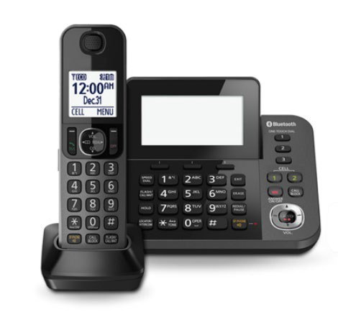
Phone Services
A Service You Can Count On
Perfect sounding connection
Never worry about your call coverage
29 popular calling features including call waiting and anonymous call rejection
Great International Rates
Competitive rates for international calling
Stay connected with family, friends and colleagues overseas
Special Community Rate!
$19.95/mo
*NOTE: If you select to add phone option, great news, you can keep your current phone number! Please call Blue Stream Fiber prior to confirm the process to port your phone number.
NOTE: Package components may vary based on what is included in your community’s agreement. Pricing subject to change.
For more information on disclaimers, taxes and fees, please visit: www.bluestreamfiber.com/legal.
Notes:
Here are 11 services/features from the website: www.bluestreamfiber.com/home-products/phone/
Caller ID, Voice Mail, Anonymous Call Rejection, Automatic Call Back, Call Forwarding Always, Call History, Call Return, Call Waiting, Enhanced 911- direct, verifiable connection to 911, Three-Way Calling & more!

Slide 40
E-bill, Proration, Taxes and Fees
Understanding the billing process and billing cycle:
Your first bill for any upgraded services will cover the cost of your first month. Please note that due to us following a standard bill-in-advance schedule, you will receive a second bill soon for your following month's services. This is normal. You’ll then fall into a regular monthly cadence for future bills
If the resident signs up for an e-bill, they can save the $6.49 monthly paper bill fee.
Here are our fees for those residents who add-on to their bulk package and what they cover:
Network Recover Fee $6.99
(IF ADD SERVICE ABOVE BULK AGREEMENT)
Helps defray costs associated with building and maintaining Blue Stream’s fiber-rich TV and broadband network and enables us to expand network capacity.
Taxes
Sales and other taxes are required to be collected by Blue Stream Fiber as part of normal local, state, and federal regulations. For more information on disclaimers, taxes, and fees, please visit www.bluestreamfiber.com/taxes-fees.
Notes:
PARAMETERS FROM PRODUCT

Slide 41

For questions or informational updates, please call your dedicated customer service line at
561-264-2889.

Slide 42
Customer Education Resources

Slide 43
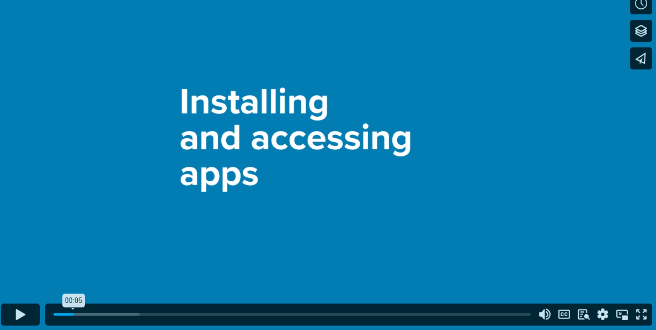
Customer Education Resources
Welcome Kit Booklet walked through and left behind during install
Personal in-home training during install
On-site group training sessions
Online resource hub with a variety of resources tailored to all learning styles
Instructional videos with step-by-step instructions on how to master new services and features included
If additional support is needed beyond these comprehensive resources, an additional one-hour in-home training is available with a tech education specialist during the installation phase through two weeks after our go-live date.

Slide 44
QUESTIONS?

